Slide 1

CSE-400 Fundamentals of Probability in Computing
Milestone – 2
Section -1
Group-13: Networks

Slide 2

An Analysis of the Binary Exponential Backoff Algorithm in Distributed MAC Protocols
Application Domain: Wireless LANs (IEEE 802.11 DCF)
Distributed Medium Access Control (MAC) protocols
Real-World Context: Multiple wireless nodes compete for a shared channel Collisions reduce productivity and efficiency
Why Uncertainty is Intrinsic: Random backoff times
Random number of contending nodes Random collisions and idle slots

Slide 3
Milestone-2 Objective
In Milestone-2, we move beyond qualitative discussion and develop a mathematical model of BEBA.
We focus on:
• Defining random variables
• Deriving probability distributions
• Modeling channel behavior using Markov chains
• Validating intuition using probability and simulation

Slide 4
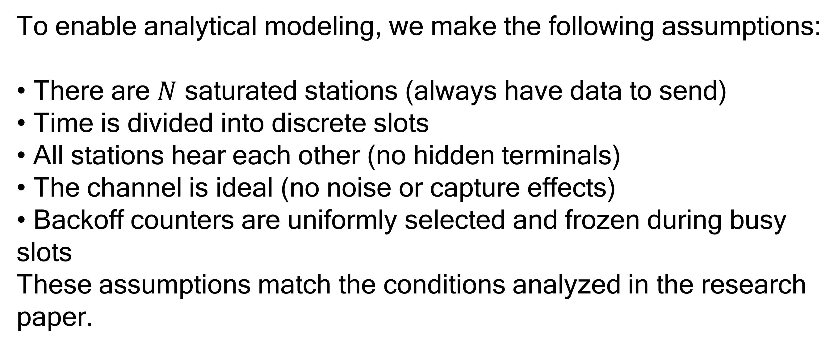
System Assumptions
To enable analytical modeling, we make the following assumptions:
• There are $N$ saturated stations (always have data to send)
• Time is divided into discrete slots
• All stations hear each other (no hidden terminals)
• The channel is ideal (no noise or capture effects)
• Backoff counters are uniformly selected and frozen during busy slots
These assumptions match the conditions analyzed in the research paper.

Slide 5
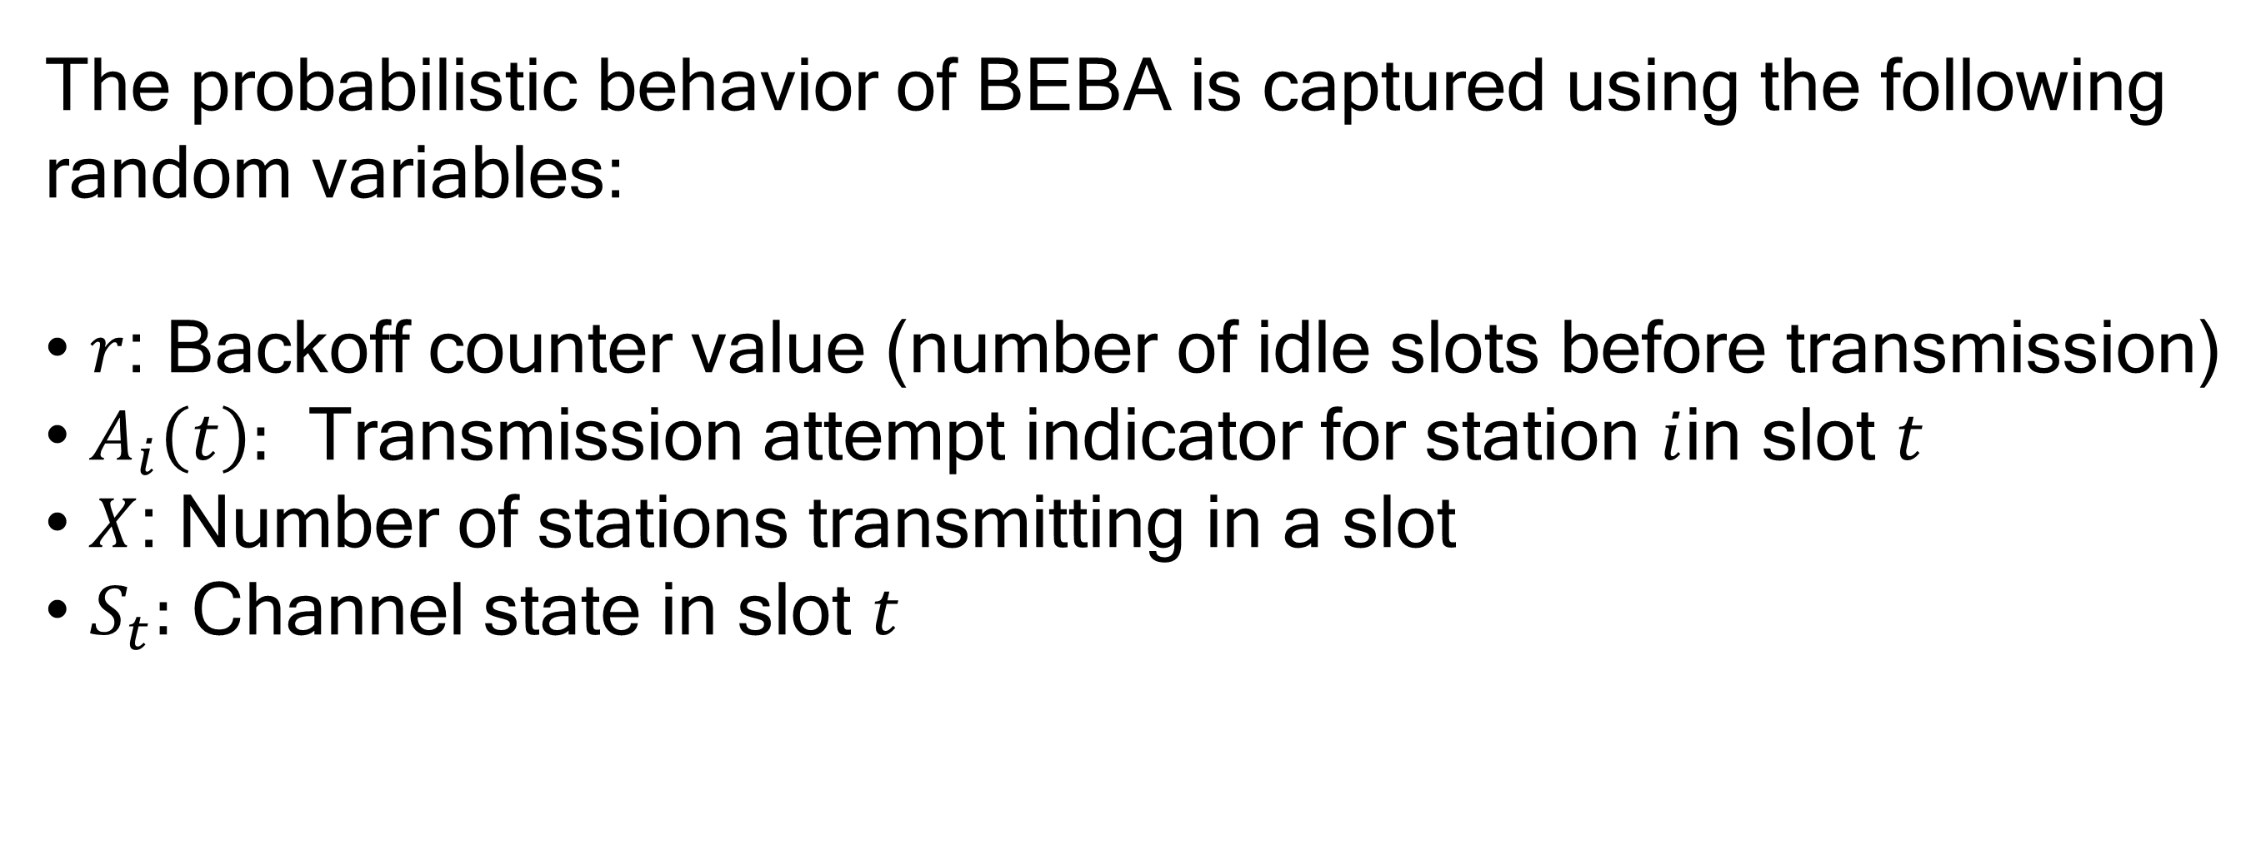
Key Random Variables
The probabilistic behavior of BEBA is captured using the following random variables:
• $r$: Backoff counter value (number of idle slots before transmission)
• $A_{i}\left(t\right):$ Transmission attempt indicator for station $i$in slot $t$
• $X$: Number of stations transmitting in a slot
• $S_{t}:$ Channel state in slot $t$

Slide 6
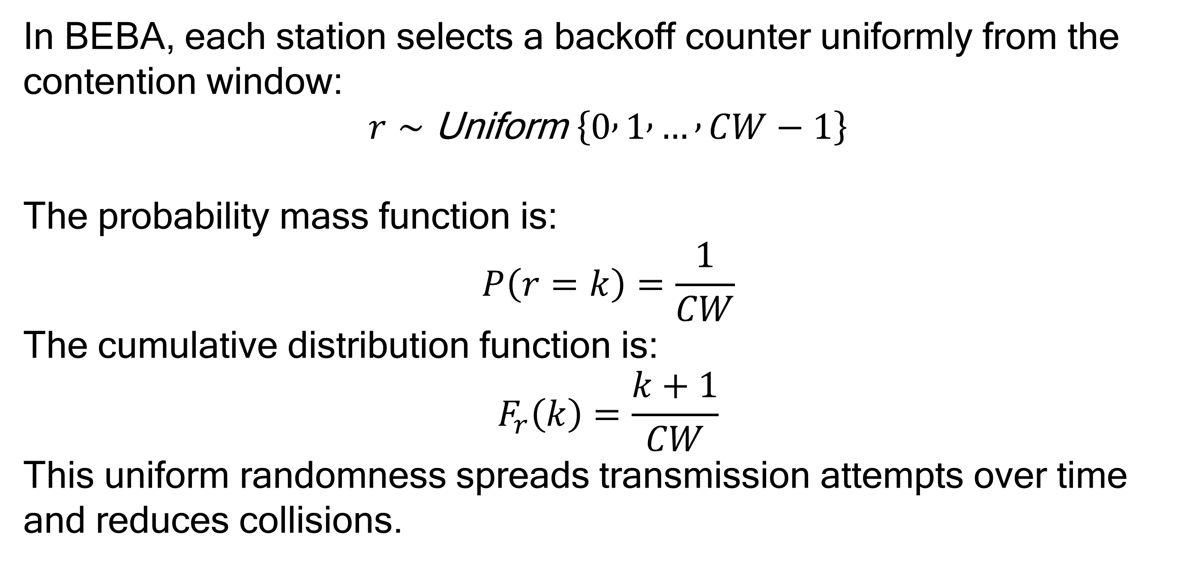
Distribution of Backoff Counter
In BEBA, each station selects a backoff counter uniformly from the contention window:
$$r∼\text{Uniform} \left\{0 , 1 , … , CW−1\right\}$$
The probability mass function is:
$$P\left(r=k\right)=\frac{1}{CW}$$
The cumulative distribution function is:
$$F_{r}\left(k\right)=\frac{k+1}{CW}$$
This uniform randomness spreads transmission attempts over time and reduces collisions.

Slide 7
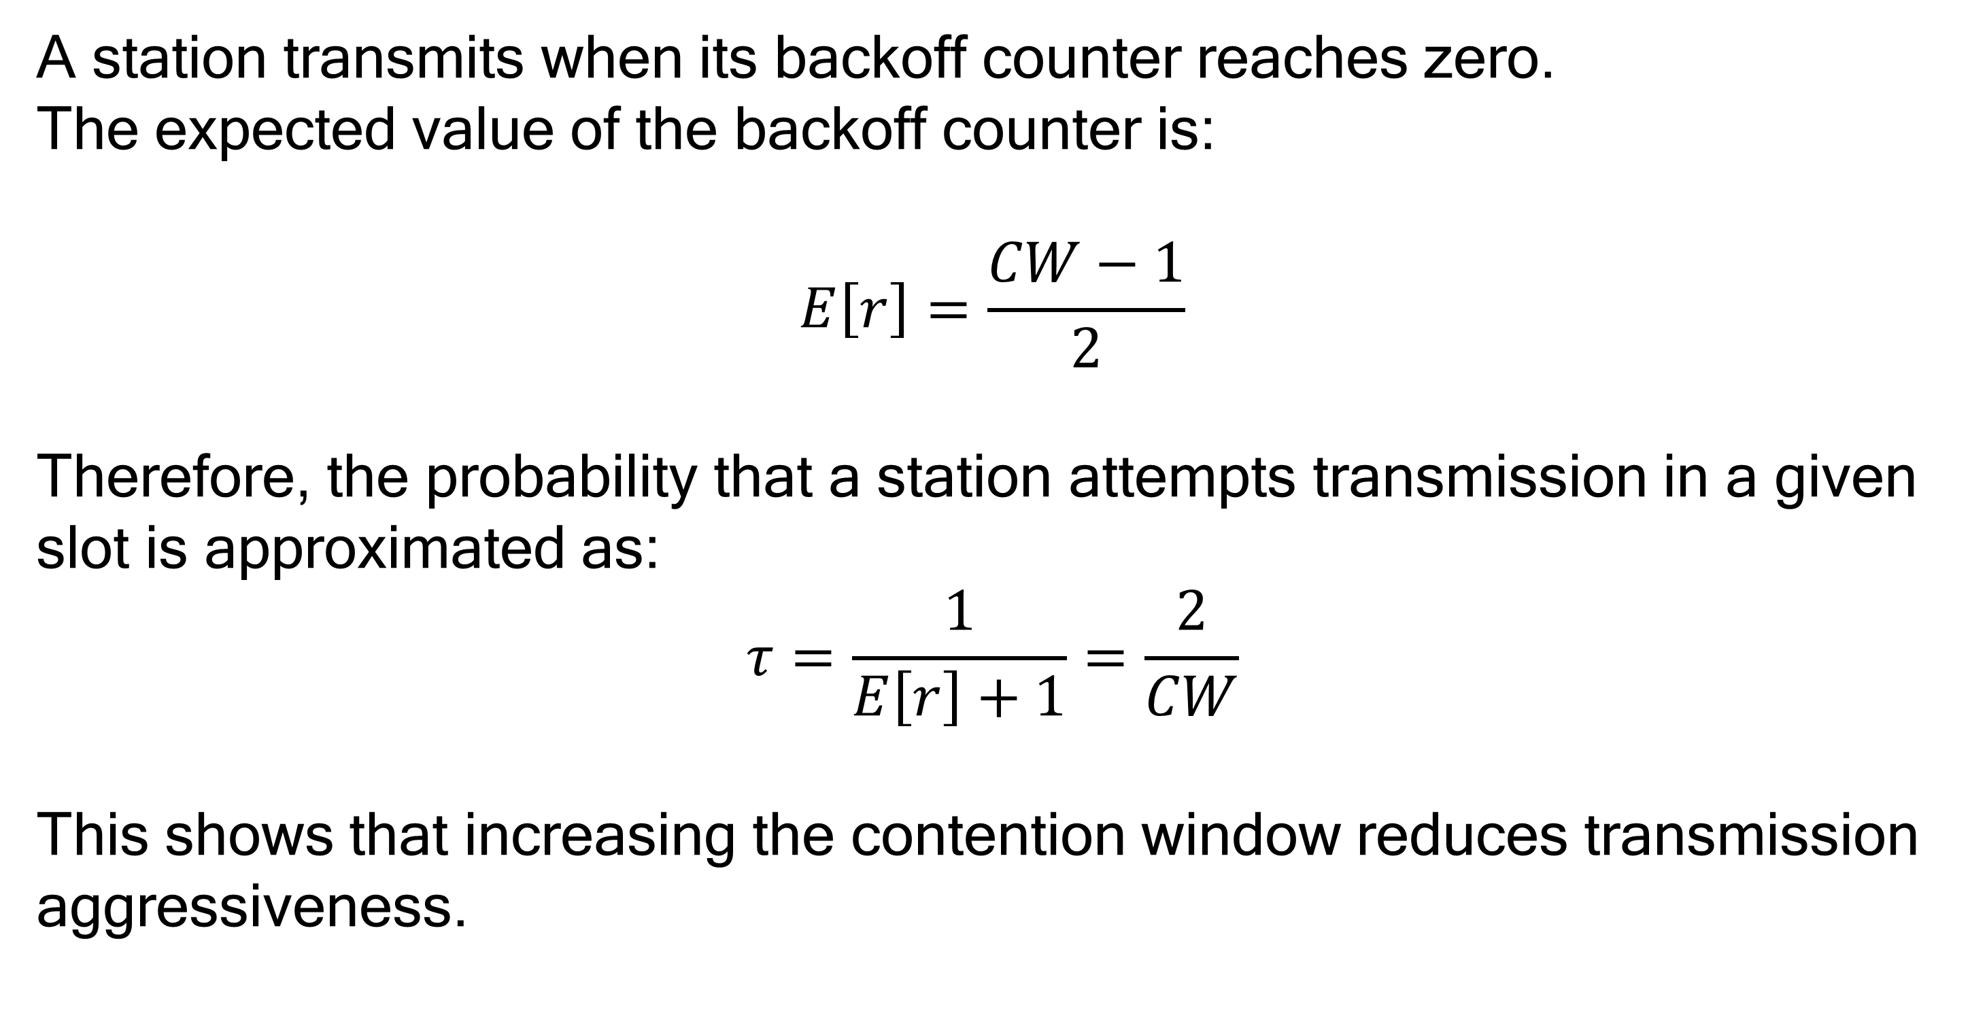
Attempt Probability Model
A station transmits when its backoff counter reaches zero.
The expected value of the backoff counter is:
$$E\left[r\right]=\frac{CW−1}{2}$$
Therefore, the probability that a station attempts transmission in a given slot is approximated as:
$$τ=\frac{1}{E\left[r\right]+1}=\frac{2}{CW}$$
This shows that increasing the contention window reduces transmission aggressiveness.

Slide 8
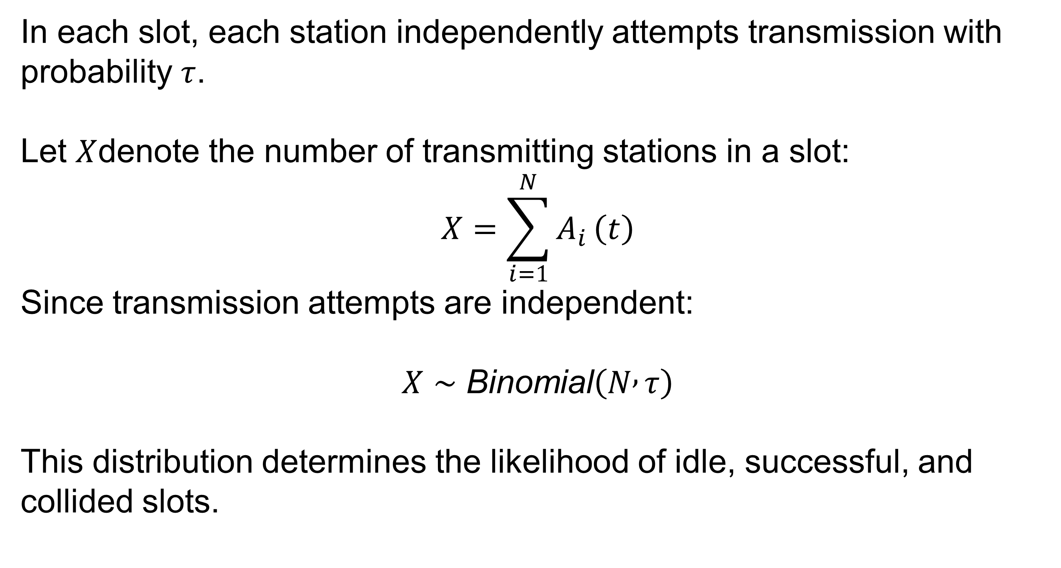
Number of Transmitting Stations
In each slot, each station independently attempts transmission with probability $τ$.
Let $X$denote the number of transmitting stations in a slot:
$$X=\sum_{i=1}^{N}{A_{i}}\left(t\right)$$
Since transmission attempts are independent:
$$X∼\text{Binomial}\left(N , τ\right)$$
This distribution determines the likelihood of idle, successful, and collided slots.

Slide 9
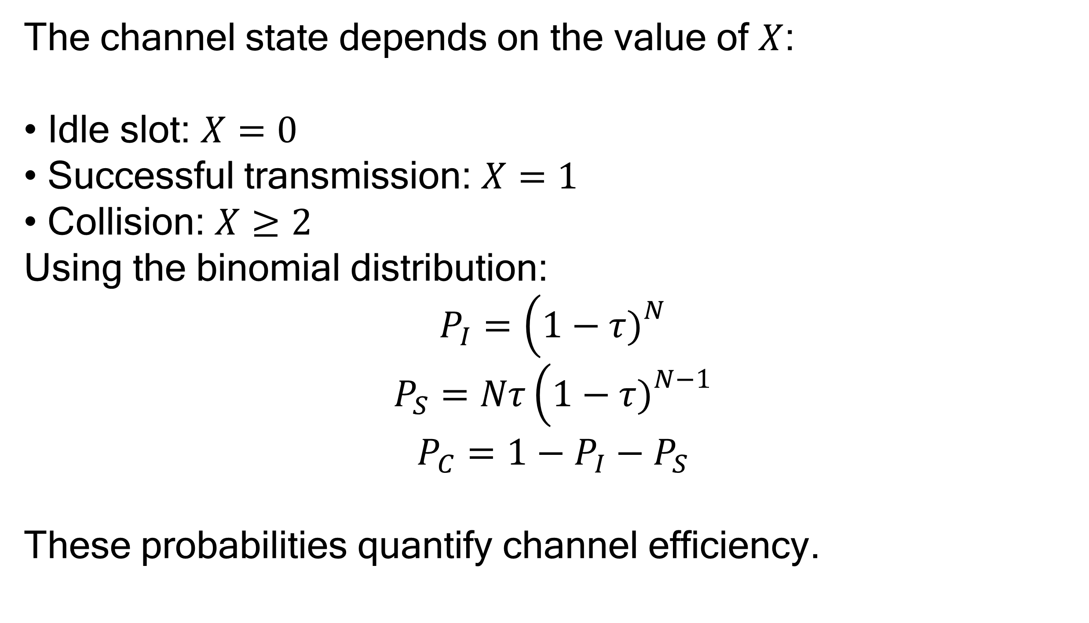
Channel State Probabilities
The channel state depends on the value of $X$:
• Idle slot: $X=0$
• Successful transmission: $X=1$
• Collision: $X≥2$
Using the binomial distribution:
$$P_{I}=\left(1−τ{\left.)\right.}^{N}\right.$$
$$P_{S}=Nτ\left(1−τ{\left.)\right.}^{N−1}\right.$$
$$P_{C}=1−P_{I}−P_{S}$$
These probabilities quantify channel efficiency.

Slide 10
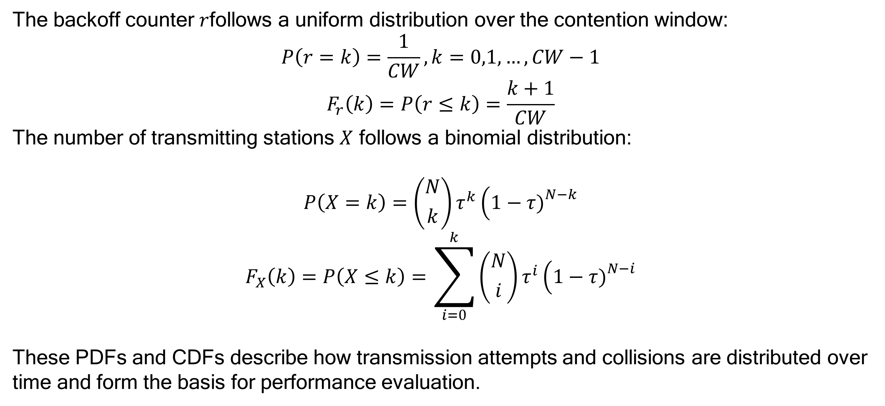
PDF and CDF
The backoff counter $r$follows a uniform distribution over the contention window:
$$P\left(r=k\right)=\frac{1}{CW}, k=0,1,…,CW−1$$
$$F_{r}\left(k\right)=P\left(r≤k\right)=\frac{k+1}{CW}$$
The number of transmitting stations $X$ follows a binomial distribution:
$$P\left(X=k\right)=\left({N \atop k}\right)τ^{k}\left(1−τ{\left.)\right.}^{N−k}\right.$$
$$F_{X}\left(k\right)=P\left(X≤k\right)=\sum_{i=0}^{k}{\left({N \atop i}\right)}τ^{i}\left(1−τ{\left.)\right.}^{N−i}\right.$$
These PDFs and CDFs describe how transmission attempts and collisions are distributed over time and form the basis for performance evaluation.

Slide 11
Limitation of Memoryless Models
Simple p-persistent models assume that every station has equal access probability after each slot.
However, BEBA behaves differently:
• After a busy slot, only transmitting stations select new backoff values
• Non-transmitting stations freeze their counters
This makes channel access state-dependent, motivating Markov modeling.

Slide 12
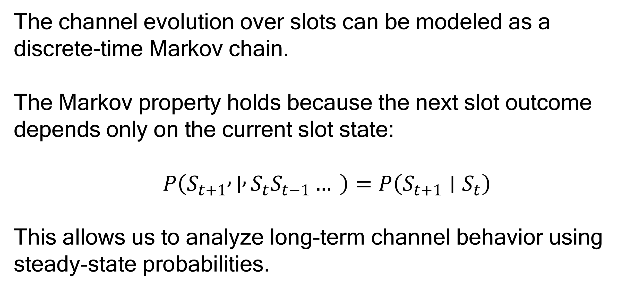
Markov Chain Modeling
The channel evolution over slots can be modeled as a discrete-time Markov chain.
The Markov property holds because the next slot outcome depends only on the current slot state:
$$P\left(S_{t+1} , ∣ , S_{t}S_{t−1}… \right)=P\left(S_{t+1}∣S_{t}\right)$$
This allows us to analyze long-term channel behavior using steady-state probabilities.

Slide 13
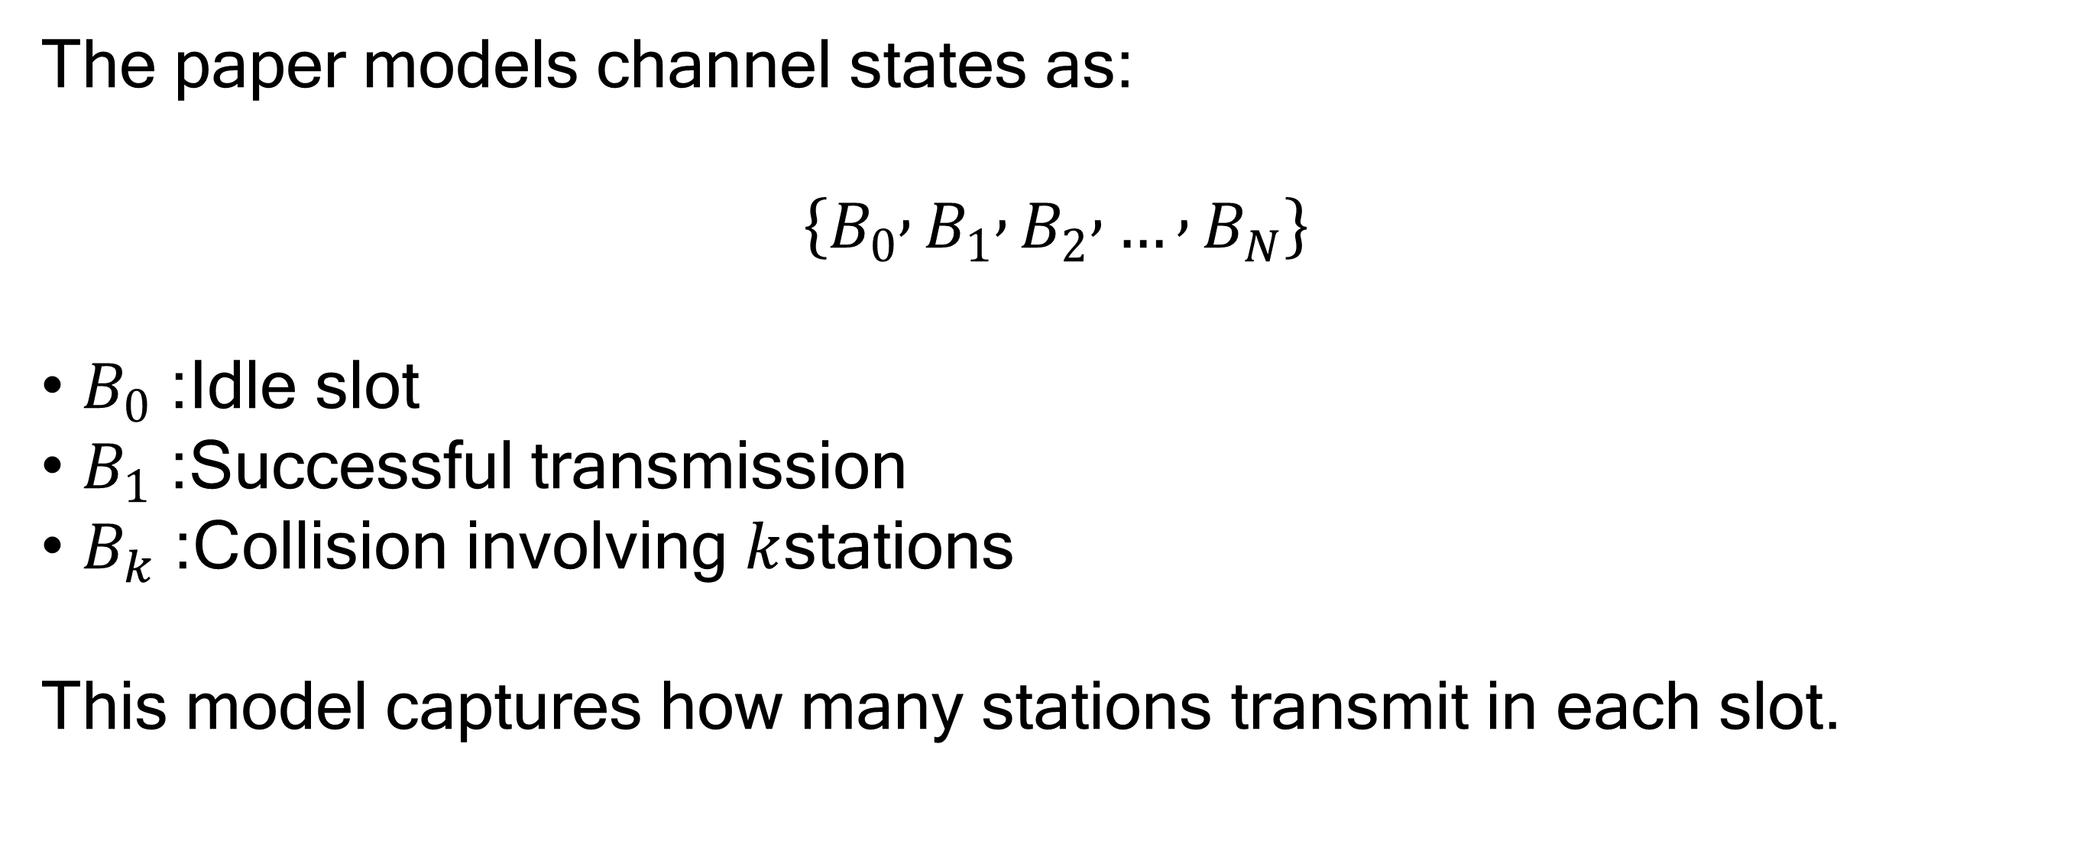
Detailed Markov States
The paper models channel states as:
$$\left\{B_{0} , B_{1} , B_{2} , … , B_{N}\right\}$$
• $B_{0}$: Idle slot
• $B_{1}$: Successful transmission
• $B_{k}$: Collision involving $k$stations
This model captures how many stations transmit in each slot.

Slide 14
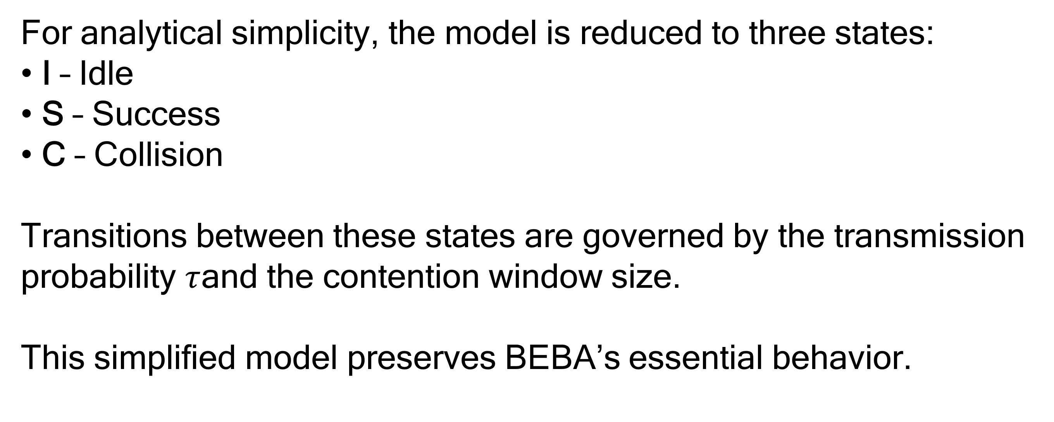
Simplified Three-State Markov Model
For analytical simplicity, the model is reduced to three states:
• I – Idle
• S – Success
• C – Collision
Transitions between these states are governed by the transmission probability $τ$and the contention window size.
This simplified model preserves BEBA’s essential behavior.

Slide 15
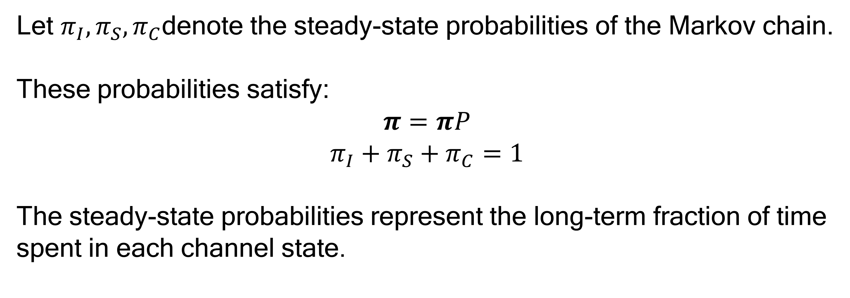
Steady-State Analysis
Let $π_{I},π_{S},π_{C}$denote the steady-state probabilities of the Markov chain.
These probabilities satisfy:
$$π=πP$$
$$π_{I}+π_{S}+π_{C}=1$$
The steady-state probabilities represent the long-term fraction of time spent in each channel state.

Slide 16
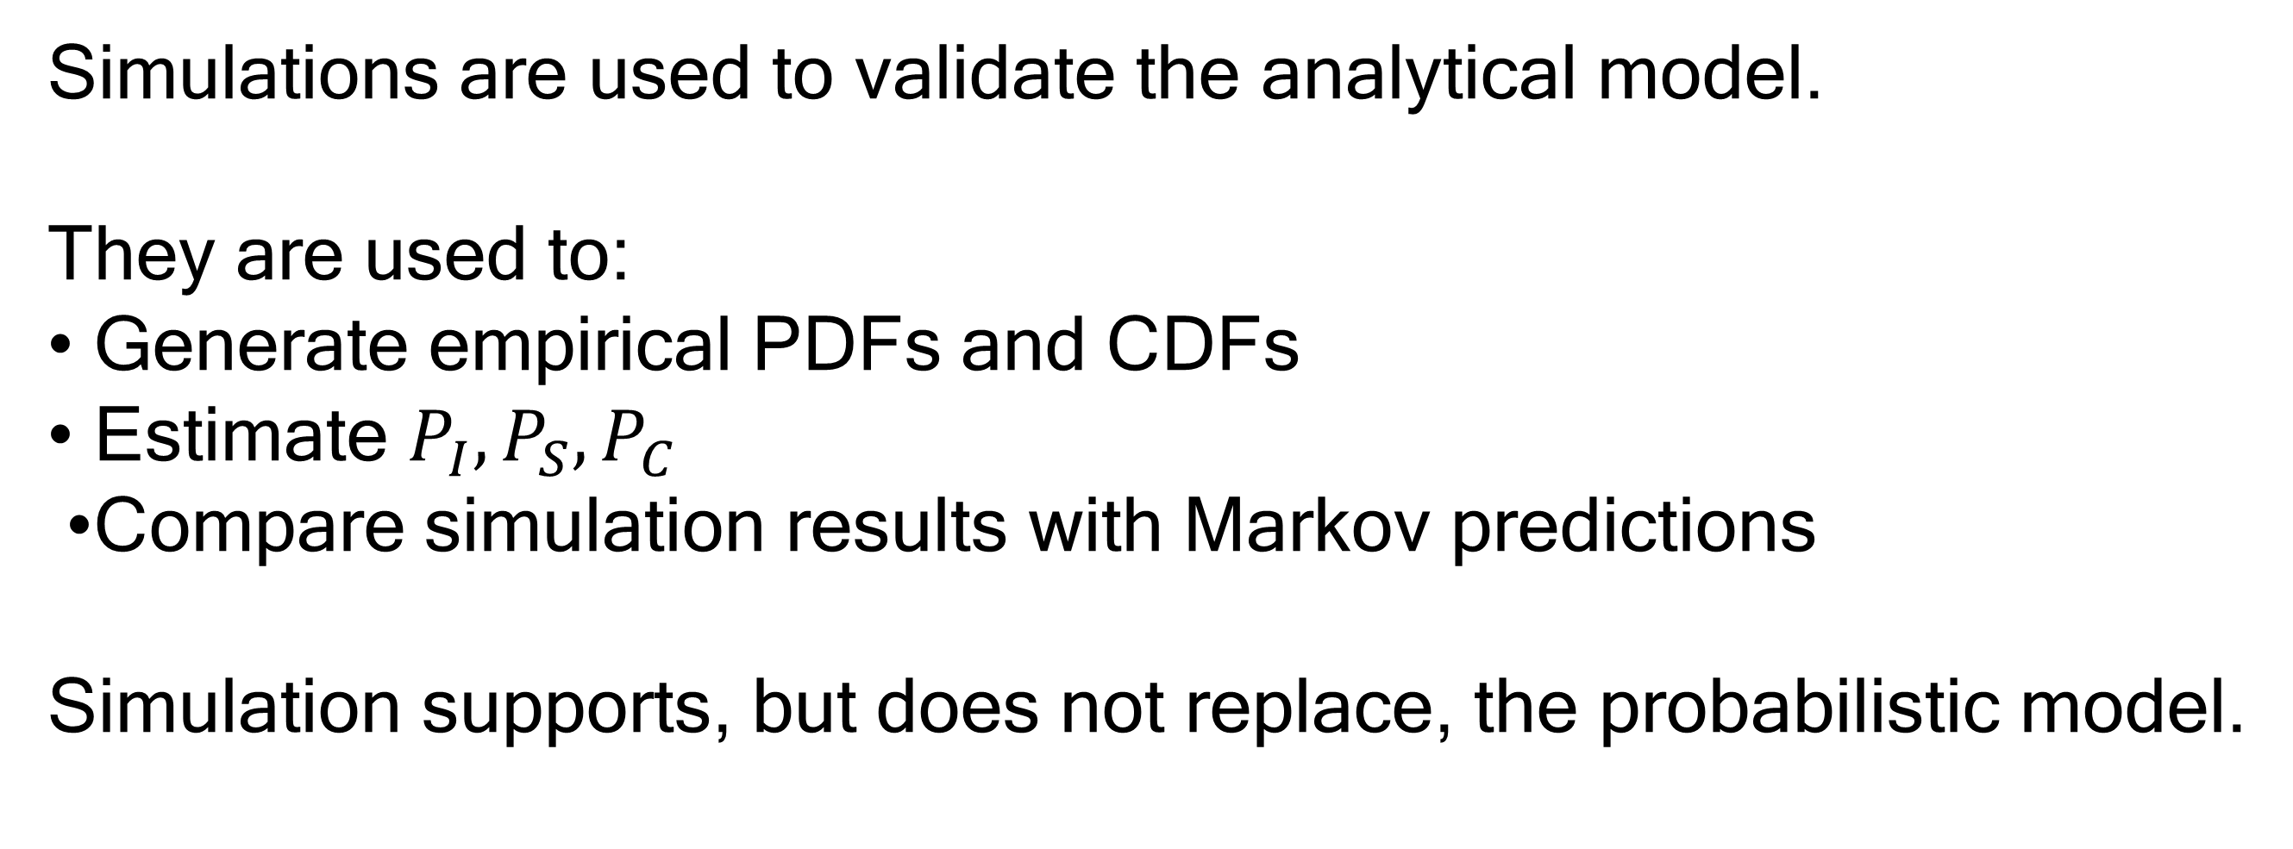
Role of Simulation
Simulations are used to validate the analytical model.
They are used to:
• Generate empirical PDFs and CDFs
• Estimate $P_{I},P_{S},P_{C}$
• Compare simulation results with Markov predictions
Simulation supports, but does not replace, the probabilistic model.

Slide 17
Conclusion & Next Steps
In this milestone, we developed a probabilistic and Markov chain model of BEBA.
Random variables and probability distributions explain how backoff controls channel access.
Markov modeling captures the state-dependent nature of BEBA.
In the next milestone, we will validate these analytical results using detailed simulations and performance evaluation.

